Slide 1
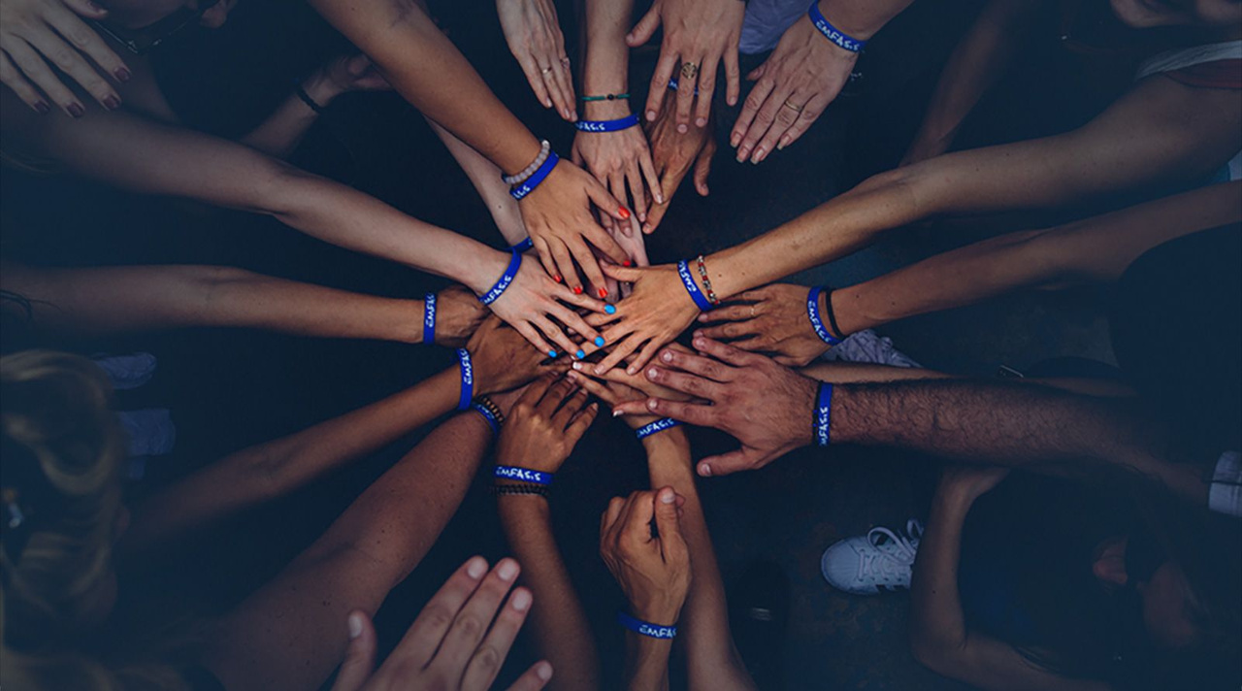

DISCOVER STUDENTS IN ACTION
AN IN-DEPTH LOOK AT MULTIPLYING GOOD'S YOUTH SERVICE LEARNING PROGRAM AND HOW TO START A NEW TEAM

Slide 2

UNDERSTANDING MULTIPLYING GOOD

Slide 3
INTRODUCTION TO THE COMPANY
From the beginning, Multiplying Good set out to celebrate and elevate the stories of those performing extraordinary acts of service all across the nation.
As we look to the next 50 years, we are on a mission to cultivate greatness through service to others. We understand that service offers each and every one of us a solution. We believe a solution lies in creating positive change through helping others. Service has the power to reconnect us to one another. It provides opportunities for us to grow as individuals and transform us into happier, more active members of society. It creates stronger, more connected communities.
Ultimately, we at Multiplying Good envision a world where service to others motivates everyone to do something that has a positive impact on those around them. The more we can bring people into service while magnifying and scaling their efforts, the greater the chance we all have to “multiplying the good” and making the world a better place.

Slide 4
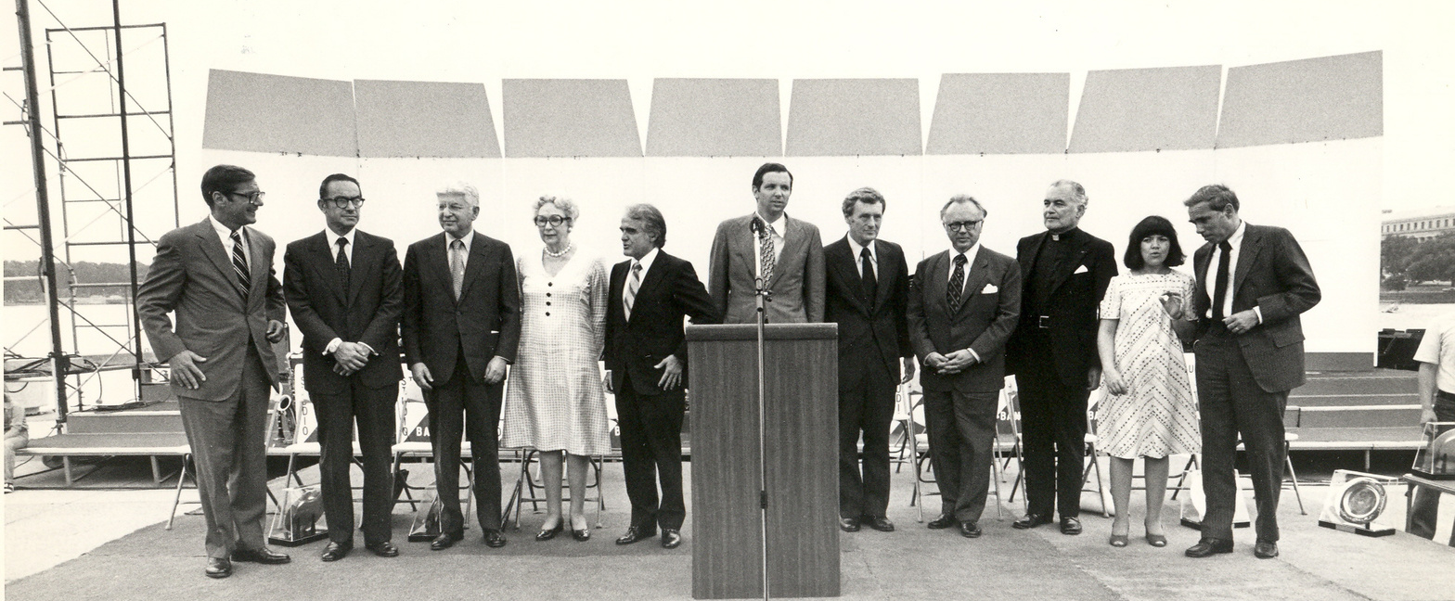
HISTORY OF MULTIPLYING GOOD
1972
1973
1977
2007
2007
2018
2022
Multiplying Good Founded
First national Jefferson Award Ceremony held In Washington D.C.
First grassroots heroes celebrated with Jefferson Awards on local TV, radio, and newspapers
Multiplying Good begins recognizing outstanding service in the workplace
Students in Action program is launched in chapters across the country
First class of local community leaders celebrated with Jefferson Awards
Multiplying Good celebrates 50th Anniversary

Slide 5

THE MISSION OF MULTIPLYING GOOD
Cultivating Greatness
At Multiplying Good, our mission is to cultivate greatness through service to others. Across five decades, we’ve seen how individuals are transformed through service, so we focus on helping people reach their full potential, and discover their power to deliver impact and bring about meaningful change.

Slide 6
VISION:
We envision a world where service to others motivates everyone
to do something that has a positive impact on those around them.
THE BRAND FOR SERVICE RECOGNITION IN AMERICA
THE RIPPLE: A MEGA FORCE FOR GOOD
1,000,000
YOUNG LEADERS
Because in order to
change the narrative, we need to see, share, and be the good.
Service is hard and inefficient. Community provides inspiration and resources. It connects. It multiplies good.
An irresistible force to affect real change - the empathetic leaders and changemakers we need.

Slide 7
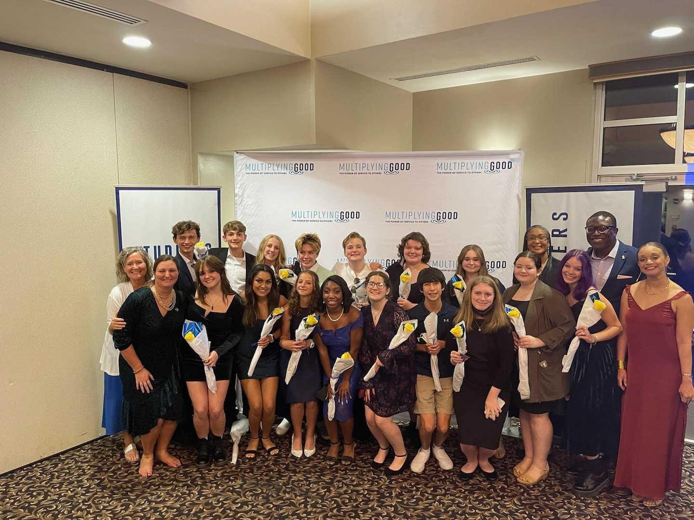
SERVICE CONNECTS PEOPLE
Nearly 43 million Americans suffer from chronic loneliness. Service reconnects people to communities, building connections and networks of support.
SERVICE OFFERS A SOLUTION
We face real problems in our country, and the impact is steadily mounting. We believe a solution lies in creating positive change through helping others. Service reconnects us to one another. It provides opportunities for us to grow as individuals. It transforms us into happier, more active members of society. It creates stronger, more connected communities.
SERVICE FEELS GOOD
Anxiety and stress are at all-time highs. Service combats depression, increases self-confidence and promotes healthy lifestyles.
SERVICE BUILDS SKILLS
50% of CEOs struggle to find employees with the skills that drive workplace success. Service delivers those skills: empathy, understanding of difference, project management, communications and results-orientation.
SERVICE CREATES COMMUNITY
Empathy rates are down by 40%. Service cultivates compassion and commitment to others.

Slide 8
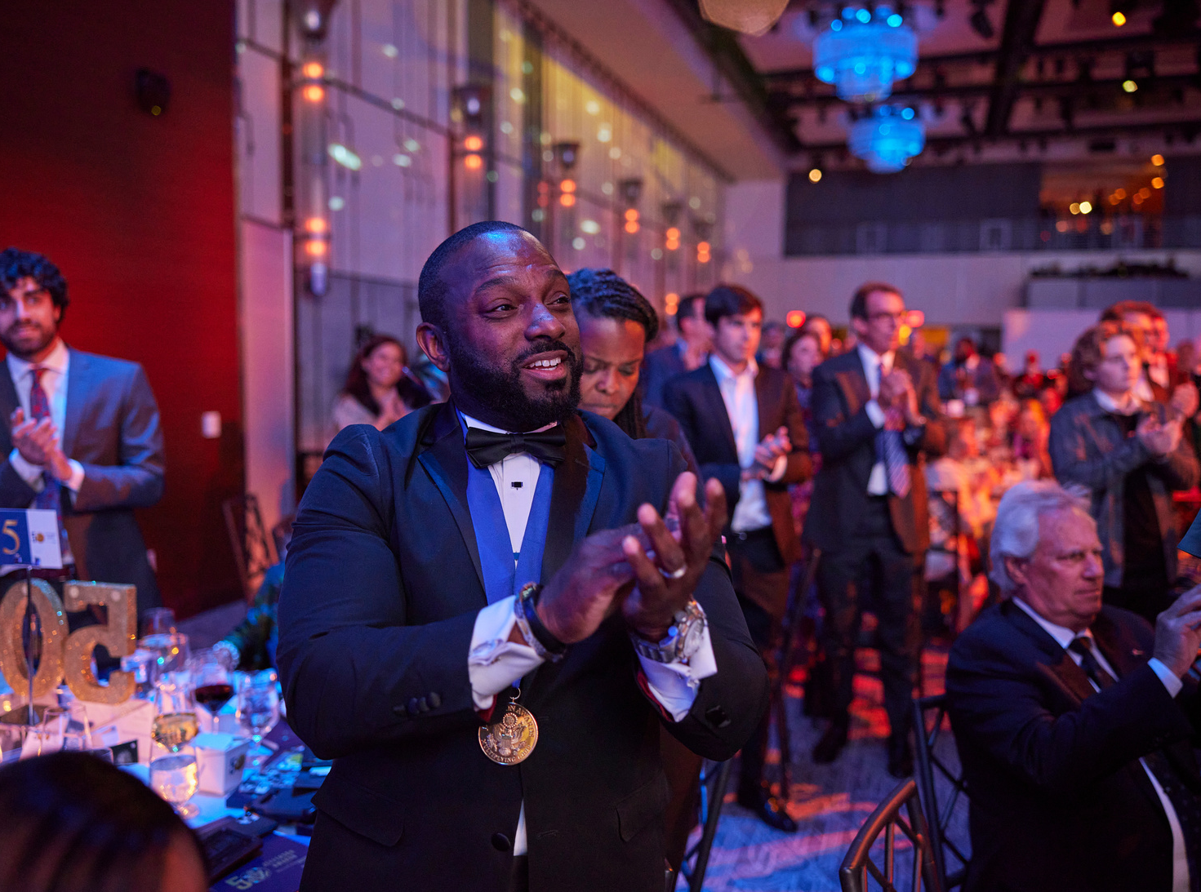
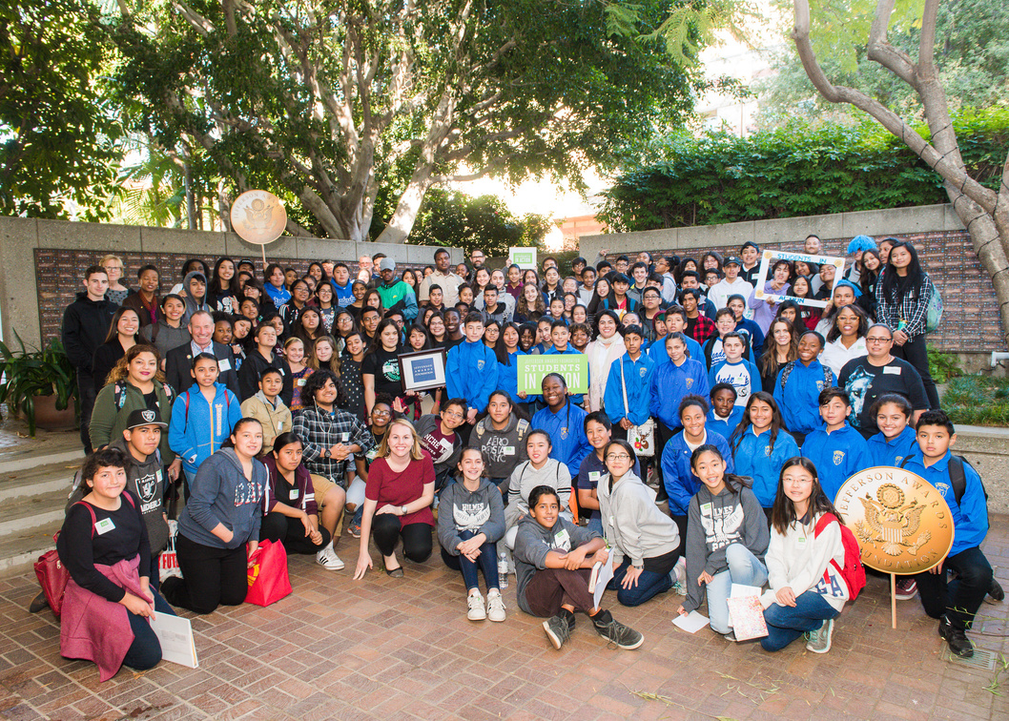
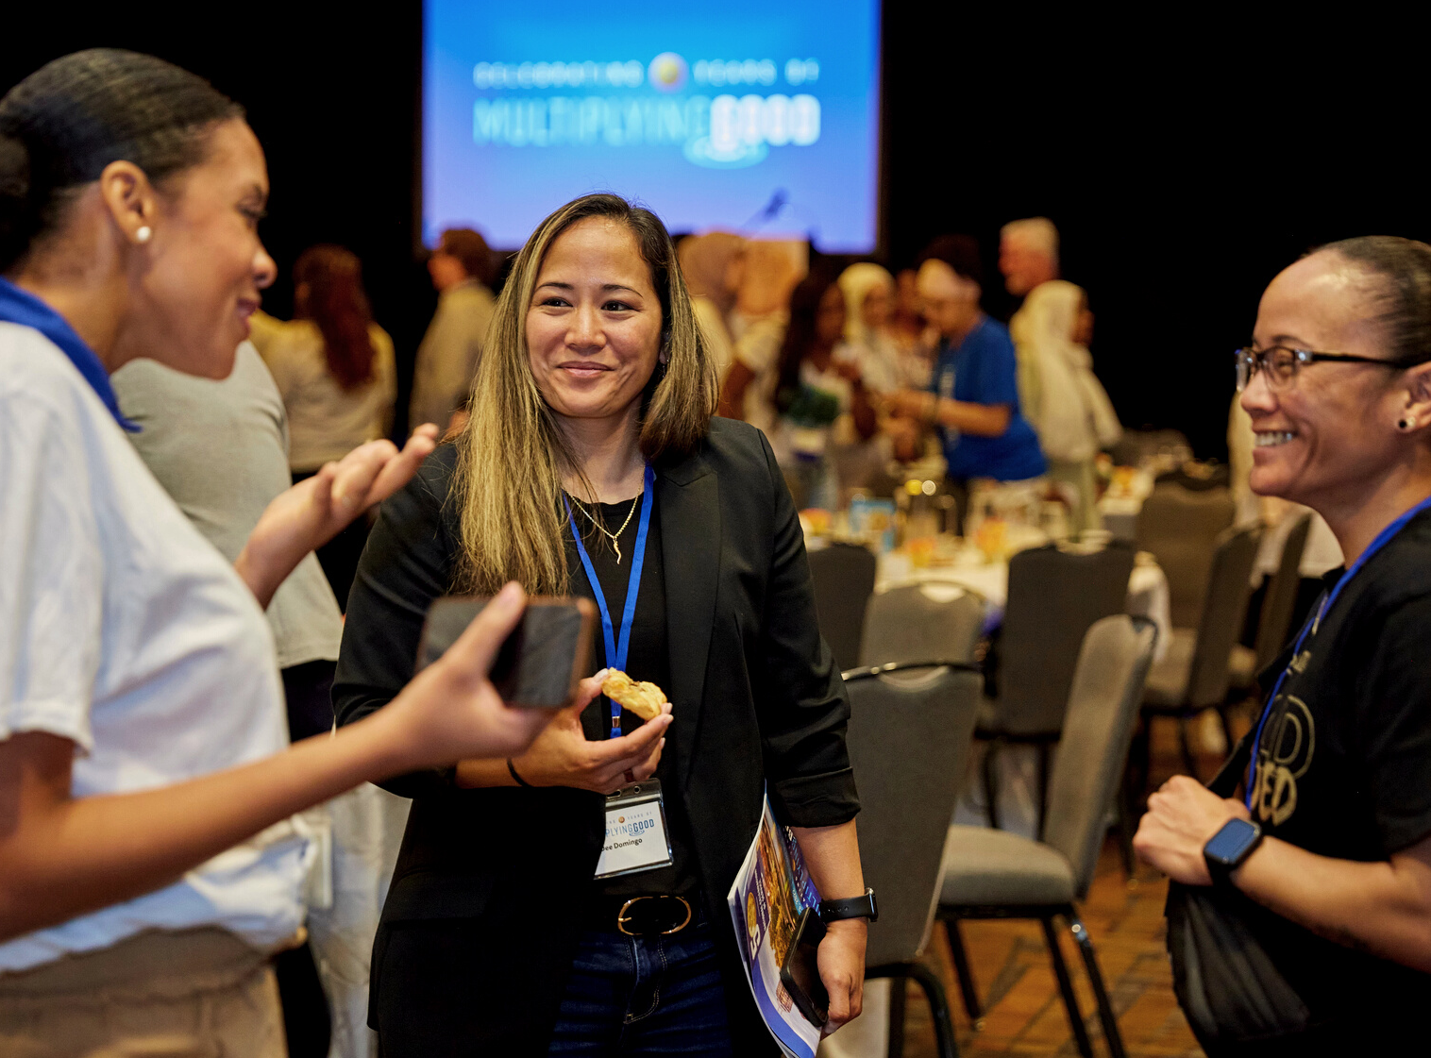
AT MULTIPLYING GOOD WE DO THREE THINGS
CELEBRATE SERVICE
CULTIVATE LEADERS THROUGH SERVICE
CONNECT SERVICE LEADERS
Since 1972, the Jefferson Awards have recognized and inspired a Who's Who of American change makers as well as more than 65,000 local unsung heroes doing great work across the nation.
Service empowers youth to make a positive impact on issues they care about and harness their purpose and passion to build a brighter future and become our next generation of leaders.
At Multiplying Good we call our community the "The Ripple" and the more we can bring people into service and connect them with one another, we can maximize their impact and empower others through service!

Slide 9
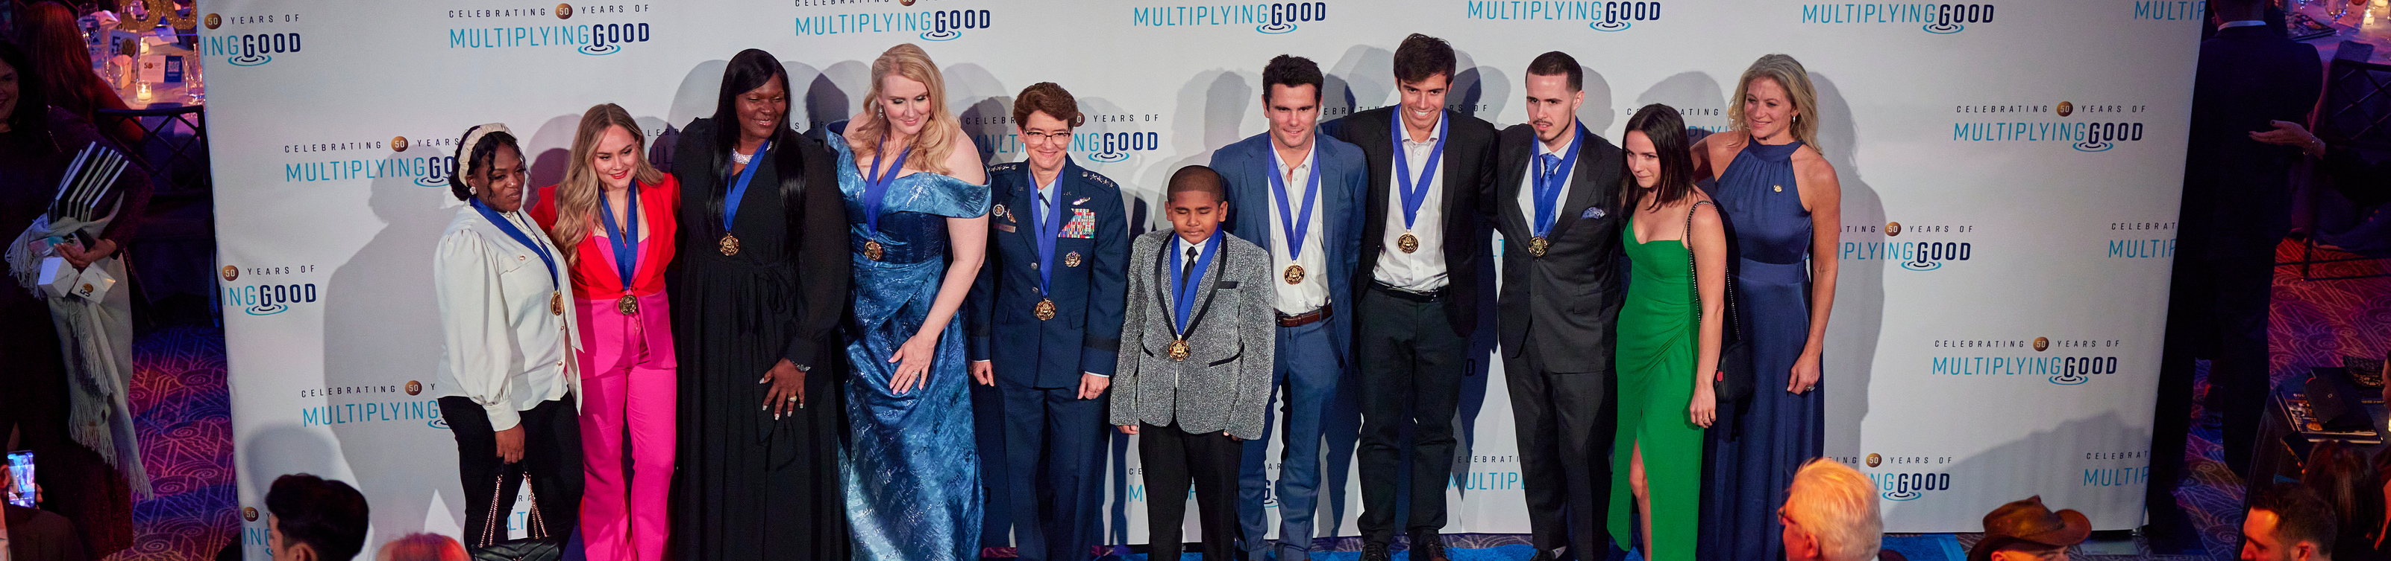
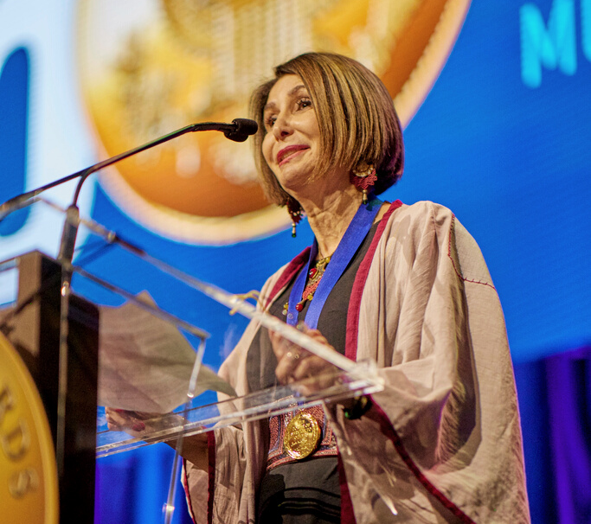
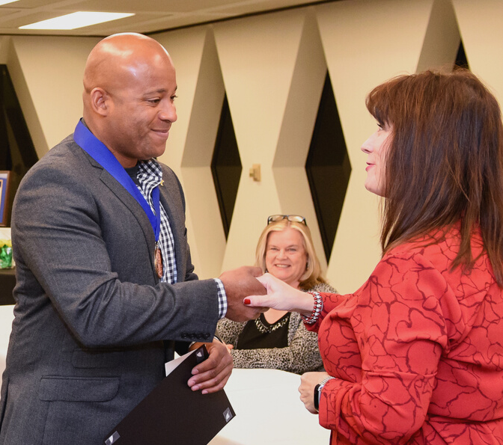
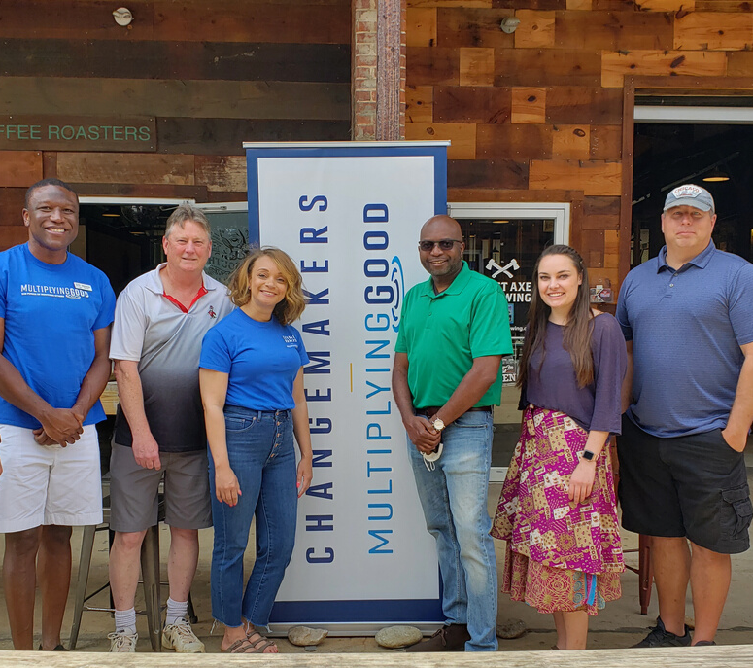
THE JEFFERSON AWARDS | RECOGNIZING OF OUTSTANDING SERVICE
CELEBRATE SERVICE
Through our Jefferson Awards, we tell stories of outstanding service, we inspire others to get involved, find solutions, and make a difference.
MEDIA PARTNERS
CHAMPIONS
CHANGEMAKERS
Celebrating grassroots heroes on air or in print
Celebrating employees in the workplace
Celebrating local leaders in their communities

Slide 10
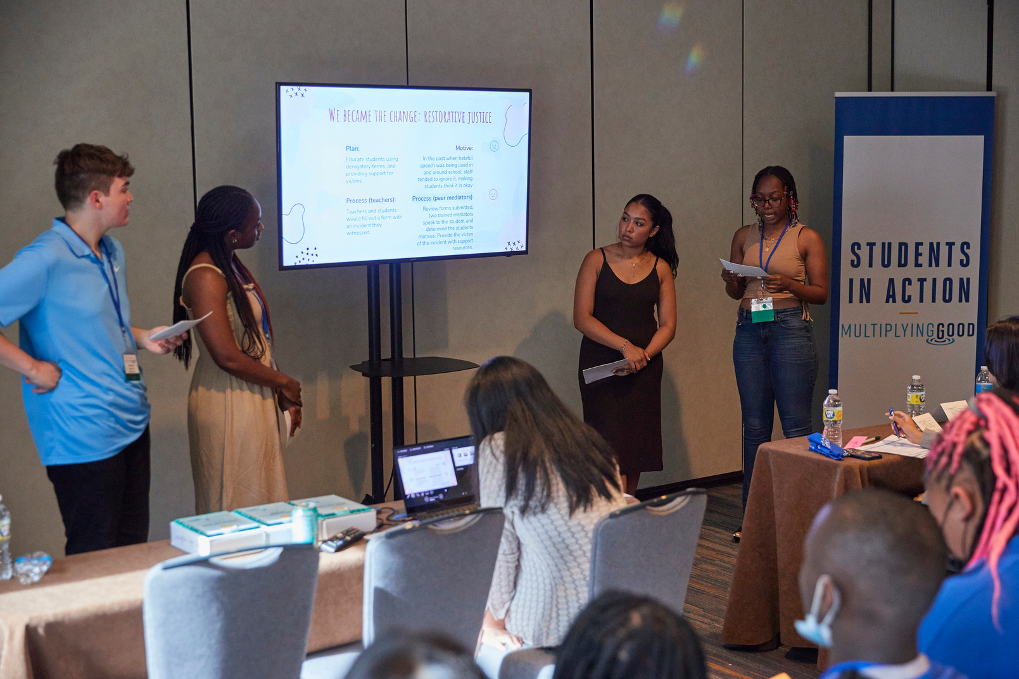
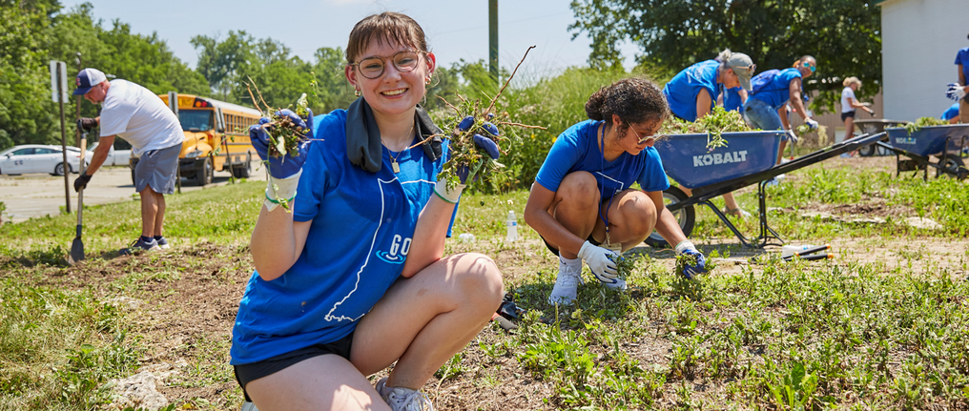
CULTIVATE STUDENT LEADERS THROUGH SERVICE
Service empowers youth to make a positive impact on issues they care about and harness their purpose and passion to build a brighter future. We have been building the next generation of leaders through Students in Action across the country for the past 15 years.
WHY WE BELIEVE IN STUDENTS IN ACTION:
It is a service, leadership, and recognition program for teenage youth.
Uses project-based service learning that empowers youth to impact their community in a meaningful way.
Builds a generation of youth with confidence in their abilities and the skills needed to excel.

Slide 11




CONNECTION ACROSS THE COMMUNITY
The Ripple brings people together from across the nation who have the goal to create a world where service has a positive impact on those around them. The more Multiplying Good can bring people into service, while magnifying and scaling their efforts, the greater the chance we all have to making the world a better place.
LOCAL MULTIPLYING GOOD CHAPTERS
NETWORK OF CONSTITUENTS AFFINITY GROUPS
MULTIPLYING GOOD PODCAST
LEARNING FOR GOOD WORKSHOPS
Our chapters are located in communities across the country, delivering on-the-ground impact where it's needed most. Our chapter boards and partners help support robust programming and make change possible.
By leveraging social media platforms, Multiplying Good is hosting and bringing together our community across various digital spaces to learn from one another and build on the work they are doing in their local communities.
Launching September 2023, this new podcast focuses on sparking change through the service of others by having meaningful conversations and sharing stories with members from our community.
The bi-monthly "Learning For Good" online series focuses on pressing topics those in various areas of care face and engages our community to share their experiences and shed light on various service topics.

Slide 12

MULTIPLYING GOOD WITH YOUNG PEOPLE

Slide 13
Service empowers youth to make a positive impact on issues they care about and harness their purpose and passion to build a brighter future.
RESEARCH SHOWS YOUTH ENGAGED IN HIGH-QUALITY SERVICE-LEARNING EXPERIENCES GAIN:
Belief in their own ability to make a difference.
Adoption of compassionate values and a sense of broader community.
Understanding and respect for other perspectives, including the reduction of stereotypes
Increased sense of civic self-efficacy and civic obligation
Improved 21st-Century skills, including critical thinking, communication, collaboration, and creativity

Slide 14
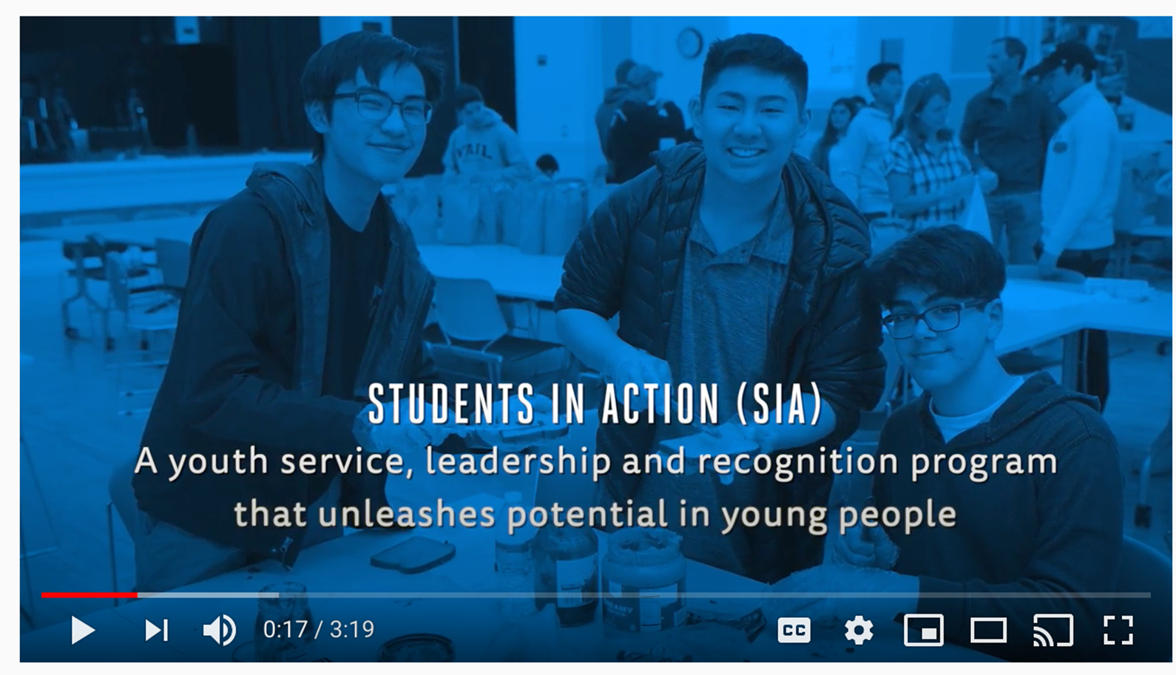

Slide 15
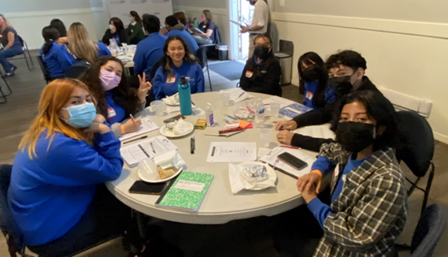
WHAT IS STUDENTS IN ACTION?

Slide 16
CULTIVATING LEADERS HAS THE POWER TO TRANSFORM
BUT WHAT IS SIA, EXACTLY?
Student-led class or club, active inside schools and community-based organizations that serve teens
Deployed nationwide across 11 chapters where Multiplying Good has staff on the ground
Led by a faculty advisory or other caring adult who brings the team together daily or weekly depending on the team's setup
Open to all students - no minimum GPA or service hours requirement
Average of 15 students per team, provided to all participants at no cost to them, regardless of their ability to pay
SIA TELLS A STORY
The power of SIA lies in student-led service. Participants plan and execute at least one high-quality, in-depth service project that focuses on an area of care:
Hunger & Homeless
Education & Youth Development
Climate Action
Peace & Justice
Physical & Mental Health
and more!

Slide 17
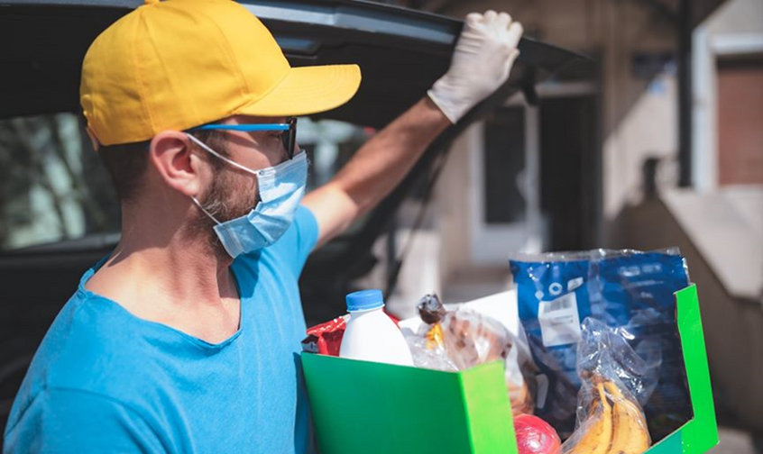
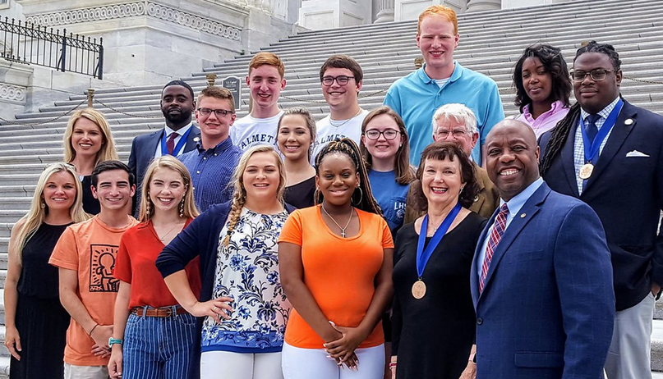
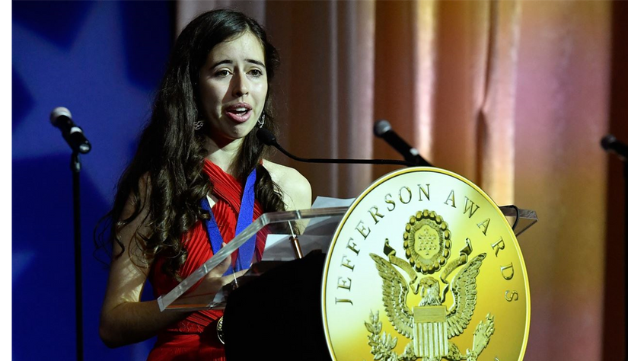
THE THREE PILLARS OF STUDENTS IN ACTION ARE:
SERVICE
LEADERSHIP
RECOGNITION
Youth plan and execute high-quality service projects
Youth use their leadership skills to set and achieve goals, expand volunteer capacity and maximize your impact
Youth inspire others to get involved and spread the message of SIA by recognizing excellence in service with the Jefferson Award

Slide 18
THE CIRRICULUM AND TRAINING
There are three settings in which youth receive our training:
STUDENT LEADERSHIP CONFERENCES
IN-SCHOOL
SESSIONS
END-OF-YEAR
REFLECTION
Twice a year, youth in a region are brought together for conferences, held in partnership with universities around the state.
These self-guided courses support SIA teams and their advisors with the tools and resources they need to meet the six goals of the program and are available on Litmos.
At the end of each year, SIA teams reflect on what they’ve learned and share it with other SIA teams + their community through a written entry and an oral presentation delivered at an event we call Public Service Pitch Day.

Slide 19
MODIFIED STUDENTS IN ACTION: JAG
Integrating service learning into JAG service project:
IN-SCHOOL
PROGRAMMING
STUDENT LEADERSHIP CONFERNCES
Age-appropriate introduction to service learning through activities (investigation, execution, reflection)
Complete simple service project
Group and individual reflection: verbal, written, video
Invitation for middle/high school-aged students to attend Fall and Winter leadership conferences
Fall Conference
Winter Conference

Slide 20
MODIFIED STUDENTS IN ACTION: AFTERSCHOOL
Block of service learning led by Program Manager:
AFTERSCHOOL
PROGRAMMING
STUDENT LEADERSHIP CONFERNCES
45-min to 90-minute blocks over 2-4 days
Age-appropriate introduction to service learning through activities (investigation, execution, reflection)
Complete simple service project
Group and individual reflection: verbal, written, video
Invitation for middle/high school-aged students to attend Fall and Winter leadership conferences
Fall Conference
Winter Conference

Slide 21
MODIFIED STUDENTS IN ACTION: SIA AS A CLASS
Led by Teacher:
IN-SCHOOL
PROGRAMMING
STUDENT LEADERSHIP CONFERNCES
45-min to 90-minute blocks
Age-appropriate lessons and activities on all six steps of service learning
Completion of student-driven service project(s)
Participation in End-of-Year Reflection
Invitation for middle/high school-aged students to attend Fall and Winter leadership conferences
Fall Conference
Winter Conference

Slide 22
MODIFIED STUDENTS IN ACTION: LIMITED OFFERING
Block of service learning led by Program Manager:
AFTERSCHOOL,
SUMMER CAMP, ETC
45-min to 90-minute blocks over four days
Age-appropriate lessons and activities on all six steps of service learning
Completion of student-driven service project(s)
Group and individual reflection: verbal, written, video

Slide 23
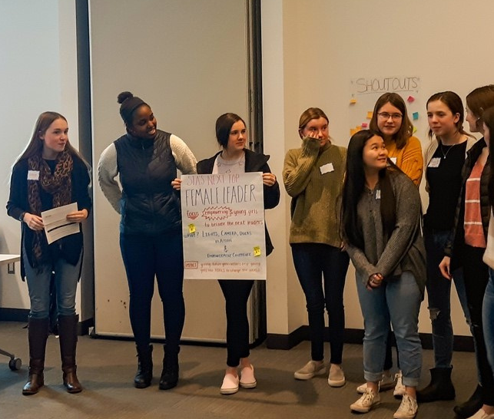
END-OF-YEAR REFLECTION PATHWAYS
IMPACTFUL
Arms young people with the leadership and life skills they need to stay on track to graduate and be successful in college and the workforce.
UNIQUE
Combines online curriculum with in-person training conferences and hands-on support from school staff, Multiplying Good Program Managers, and community volunteers to teach youth how to address real community needs in the world around them.
PROVEN
Backed by research and evaluation on its efficacy.
EQUITABLE
Provided completely free of charge regardless of a student’s ability to pay—the program is funded by individual donations, grants, and corporate gifts.

Slide 24
END-OF-YEAR REFLECTION PATHWAYS
Regardless of EOY Reflection Pathway chosen, every team is invited to the End-of-Year Celebration event in April
IMPACT PATHWAY
CERTIFICATE PATHWAY
BANNER PATHWAY
IMPACT FORM
IMPACT FORM
ONE-MINUTE SPEECH
IMPACT FORM
ONE-MINUTE SPEECH
ORAL PRESENTATION
SERVICE RESUME
SERVICE RESUME
AND FRAMED CERTIFICATE
SERVICE RESUME
ELIGIBLE FOR BANNER, SUPERLATIVES, NATIONAL

Slide 25
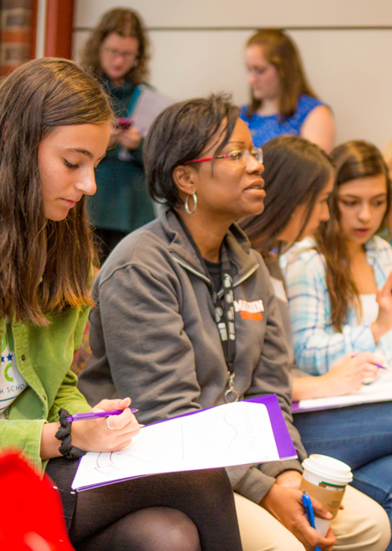
WHAT WE MEASURE
SIA BUILDS SKILLS IN YOUTH, WHO IN TURN IMPACT THEIR PEERS AND COMMUNITY
We measure impact on participating youth using pre and post-surveys that assess change over time in relation to:
Commitment to the community
Empathy
Leadership
Career preparedness
Impartiality
Community service self-efficacy
Goal setting
Communication
We measure community outputs in relation to:
Number of service projects
Hours served
Individuals impacted
Financial resources donated

Slide 26

THE HEART OF STUDENTS IN ACTION:
SERVICE LEARNING

Slide 27
WHAT IS SERVICE-LEARNING?
HOW IS IT DIFFERENT FROM COMMUNITY SERVICE?

Slide 28
THE SIX STEPS OF STUDENTS IN ACTION
PREPARE
INVESTIGATE
EXECUTE
REFLECT
SHARE
CELEBRATE
Prepare to serve your community
Investigate community needs
Execute and capacity build high-quality service project
Evaluate success
Tell service stories and expand the mission
Recognize and celebrate excellence in service
Notes:
Emily
The parts of the IPARDE process directly map to the 6 steps of SIA—so through the program young people are preparing, investigating, executing, reflecting, sharing and celebrating

Slide 29






WHAT MAKES A GREAT SERVICE PROJECT?
LEARNING OR EDUCATION
02
ON-GOING SUPPORT
02
Whenever SIA teams are doing a project and learning about an issue, they should be educating those that they engage in their project about the issue.
Great projects always think about how to support or encourage positive ongoing action, even after the project is complete, both for those receiving help and those supporting the action.
DIRECT ACTION
REFLECTION/DEMONSTRATION
Great projects always help those engaged, even just peripherally, understand the impact that was made.
The best service projects include action that is direct in at least some capacity, connecting the helpers with those they are helping.
01
03
Notes:
Emily
The purpose of this framework is to help youth build the skills we are measuring and that happens both as a result of going through the steps of the SIA/IPARDE AND through going deep with the service work. These are the components of a great project

Slide 30
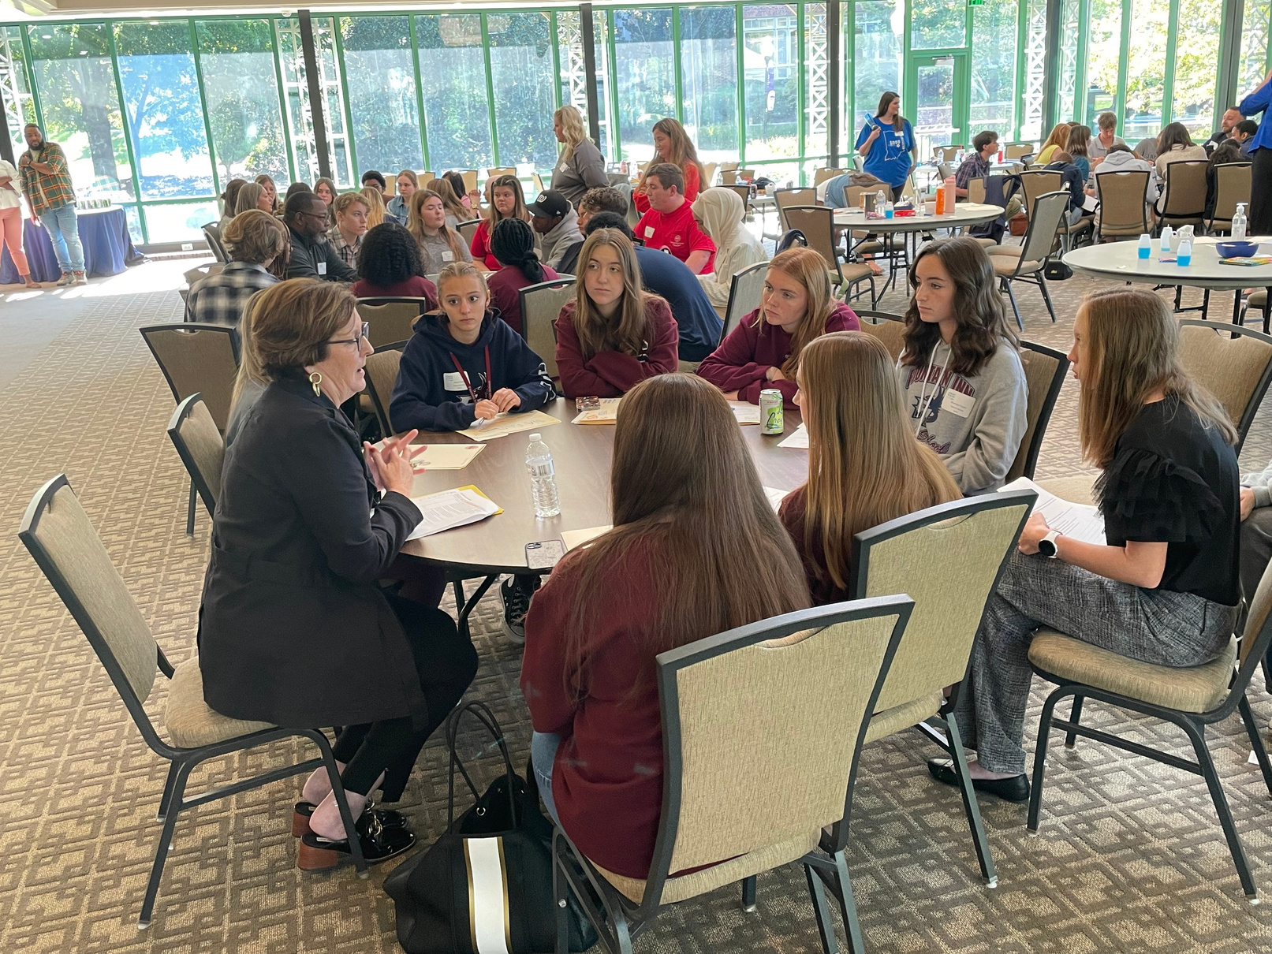
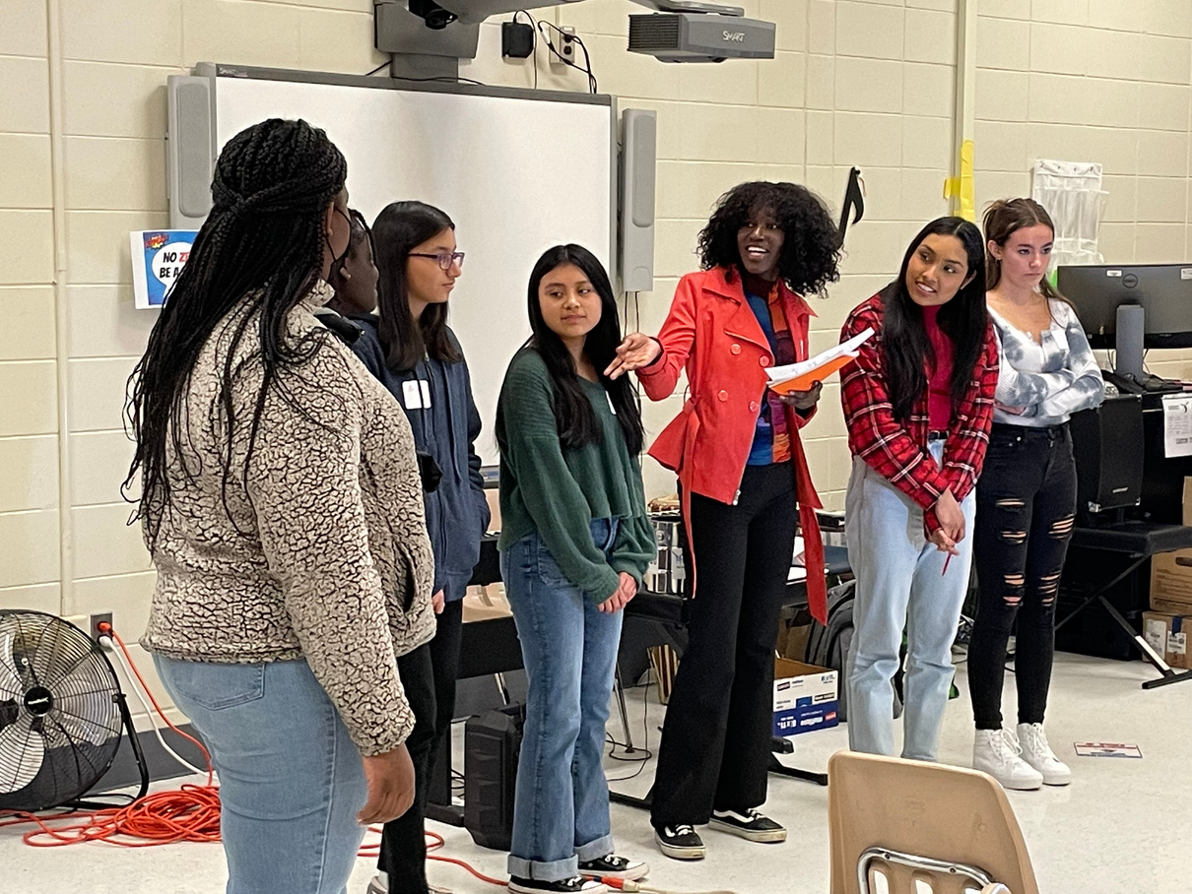
IMPACT OF VARIOUS SIA PROGRAMS
Traditional
Preparation
Investigation
Execution
Reflect
Share
Celebrate
MODIFIED
Investigation
Execution
Reflect

Slide 31
ADVISORS: COACH, MENTOR, CHEERLEADER

Slide 32
EXPECTATIONS OF SCHOOL
Sign the MOU whenever there is a new advisor or principal.
Support team in executing on the basics of SIA: one project, engaging peers, Jefferson Awards.
Ensure teams attend at least one SIA conference each year (Nov, Feb) and participate in end-of –year reflection (April).
Connect monthly with the Program Manager and invite the Program Manager to SIA meetings.
Support, encourage, and empower your youth to serve, lead and recognize!

Slide 33
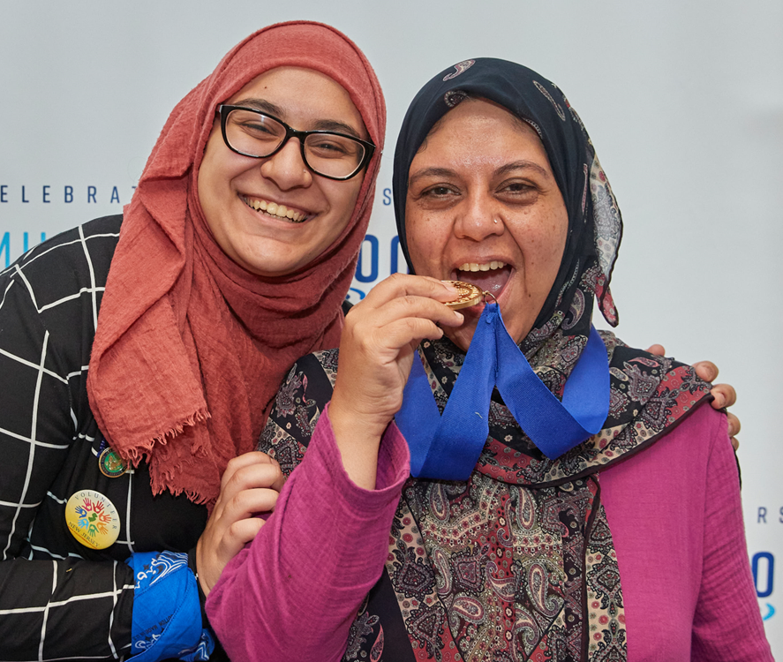
ROLE OF SCHOOL ADVISOR
MEET with teams and students weekly, bi-weekly, or monthly
SUPPORT FACILITATION of SIA planning or learning activities and team meetings. When appropriate, handing over meeting leadership to student leaders (e.g. president, chair, etc.)
COACH students as they go through the service-learning process, provide feedback, help teams address challenges, create the space for meaningful and inclusive learning.

Slide 34
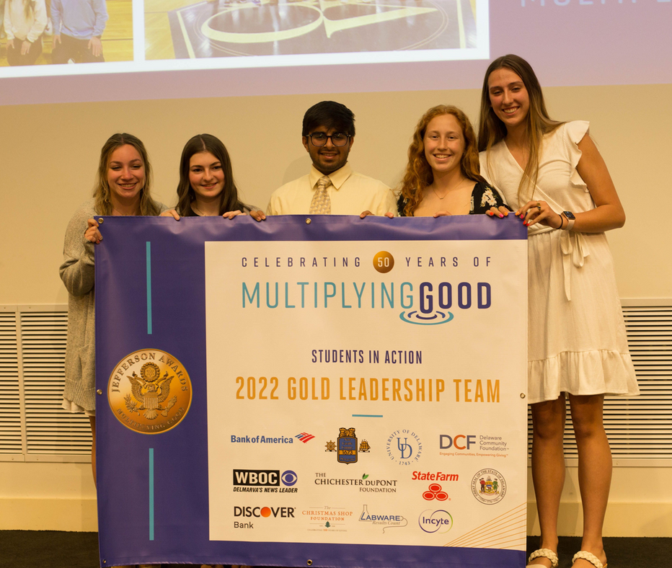
ROLE OF MULTIPLYING GOOD
EXPERTISE as subject-matter expert on service-learning process and local and national service projects. Share with teams via newsletters, in-person meetings, Zoom or calls, and Conferences. Other tools include Litmos, Member Portal, and classroom curriculum.
SUPPORT and help teams start (and re-start), assist teams through stages of service learning, and End-of-Year Reflection preparation. Financial support in the form of mini-grants and sending one advisor and two students to national Youth Summit (transportation, rooming, ticket).
CONNECT SIA teams with each other, local Jefferson Award winners, and service community and volunteer opportunities.

Slide 35
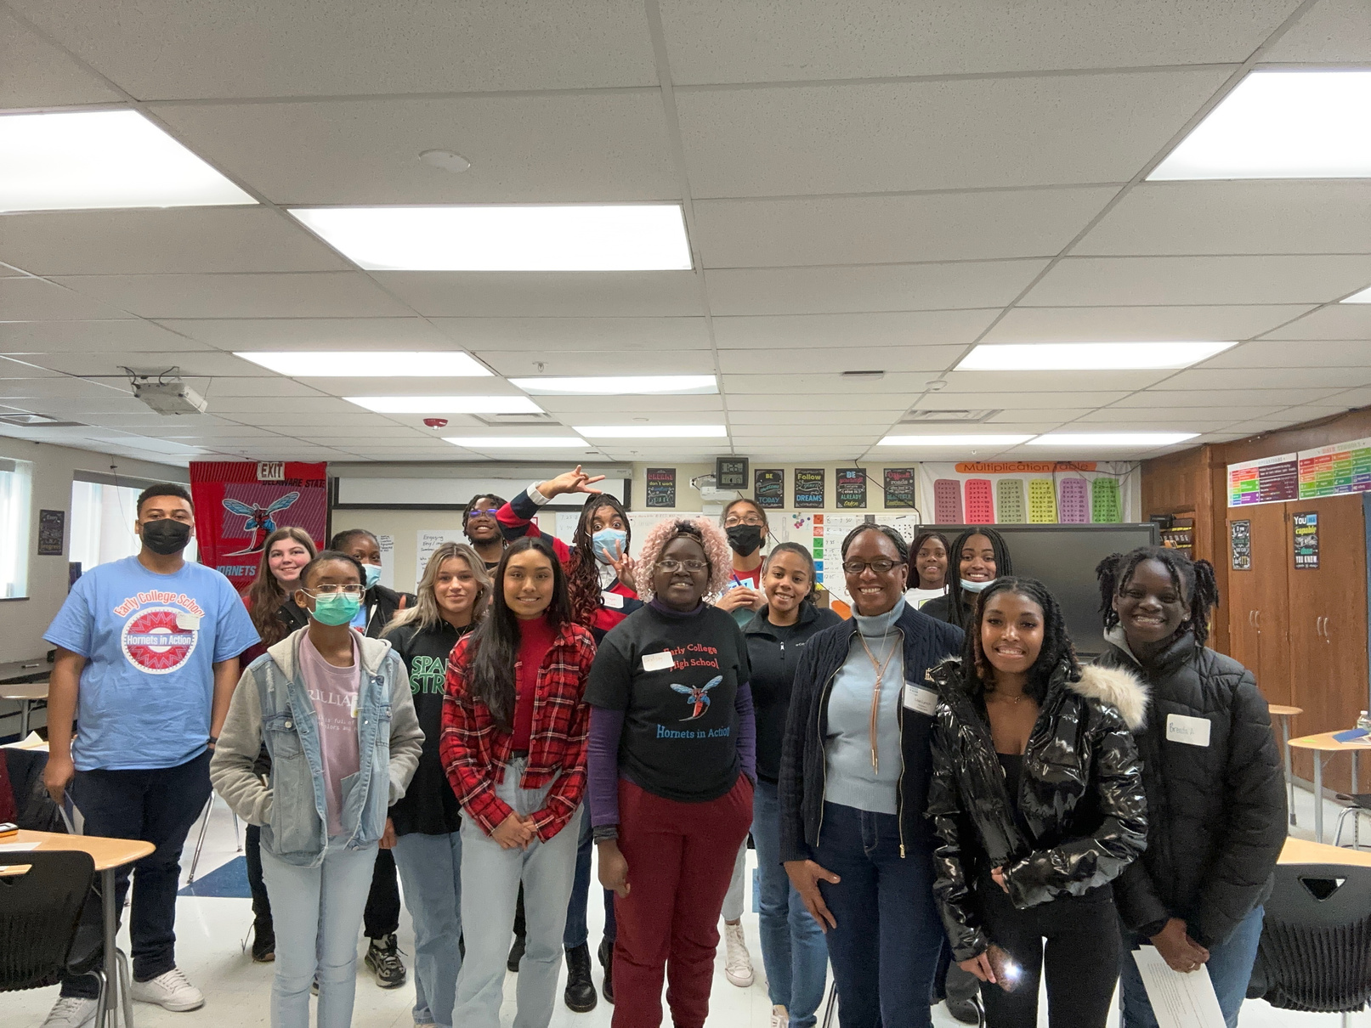
The average team is between 10 - 20 students and meets once a week or once every two weeks.
Each SIA team is different. Some are runs as a class, others as club and all are in different stages of development.
SIA can be part of an existing service club or a stand-alone. The overall goal of the program is to expand volunteer capacity.
IDEAS FOR
NEW SIA TEAMS
As an advisor, you don’t have to be an expert in service or service-learning, that’s where Multiplying Good comes in!

Slide 36
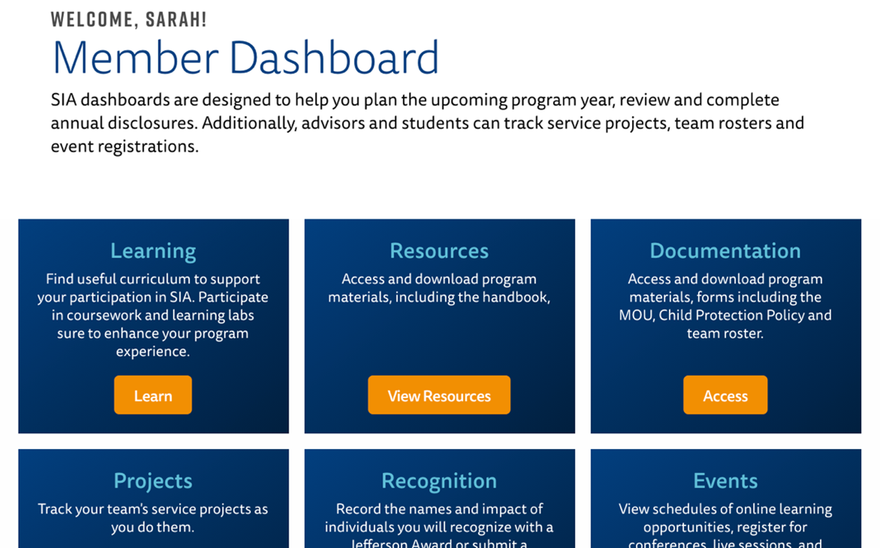
TOOLS AND RESOURCES
WE ARE HERE TO HELP!
Litmos Courses
What is SIA?
What is My Role in SIA?
The Six Steps
Program Documents
SIA Handbook
Step-by-Step Guide
Quarterly Checklists

Slide 37


